Slide 1
AI and Energy Using Low Code StackAI for Exploring State Incentives for Renewables and Efficiency
Anjuli Jain Figueroa

Slide 2
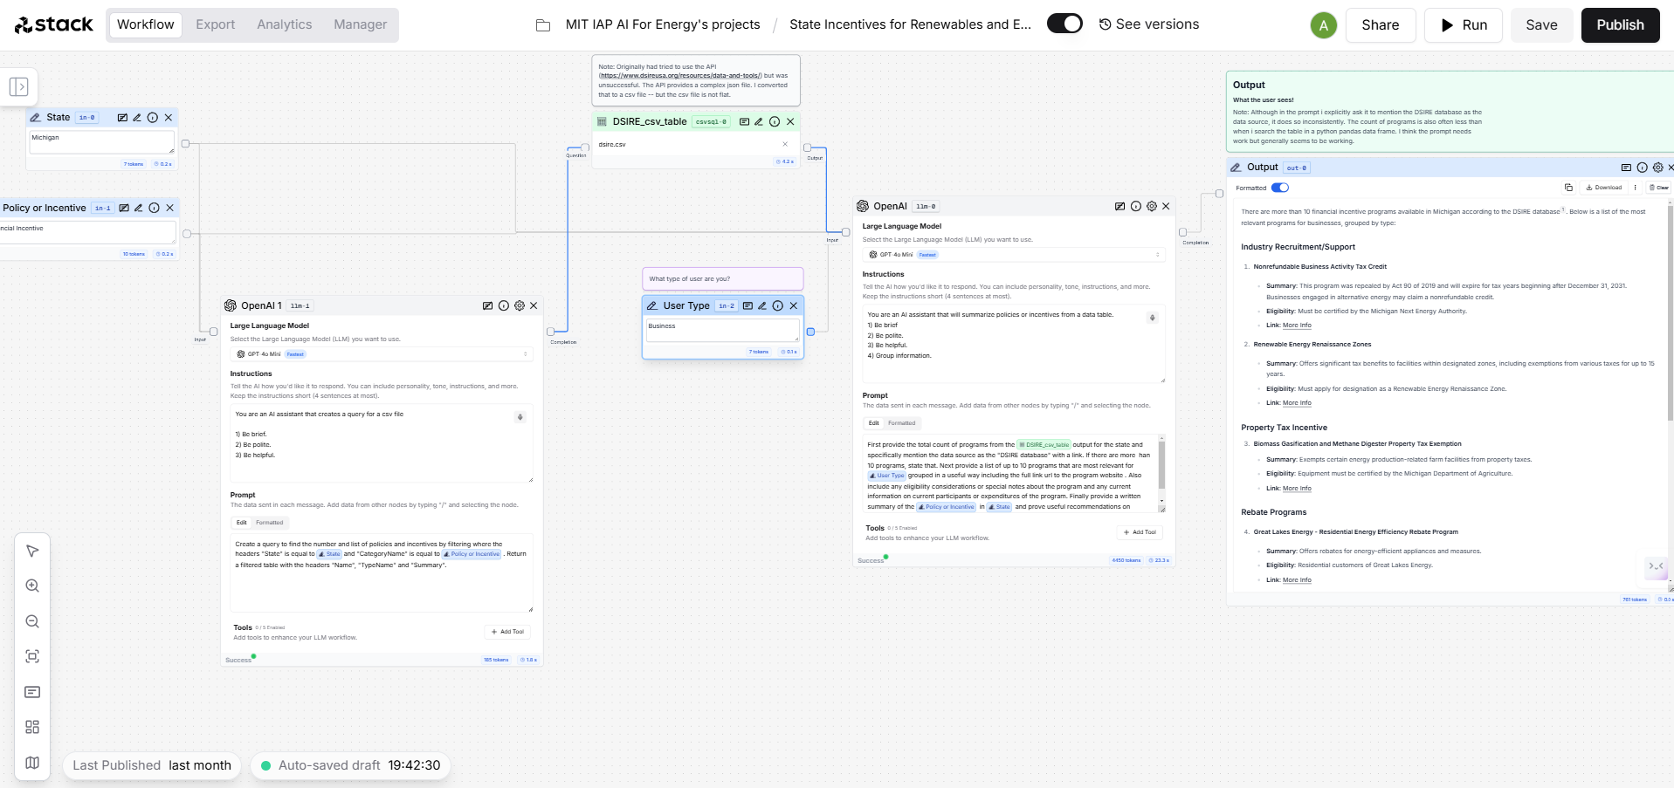
Workflow
Input: State
DSIRE
Database
LLM 2 prompt
LLM 1 prompt
Input:
“Policy”
or
“Incentive”
Input: User Type

Slide 3
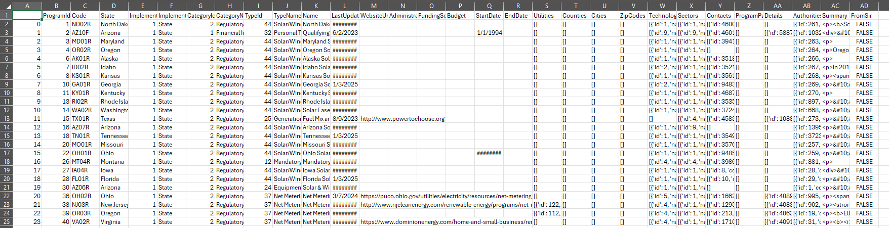
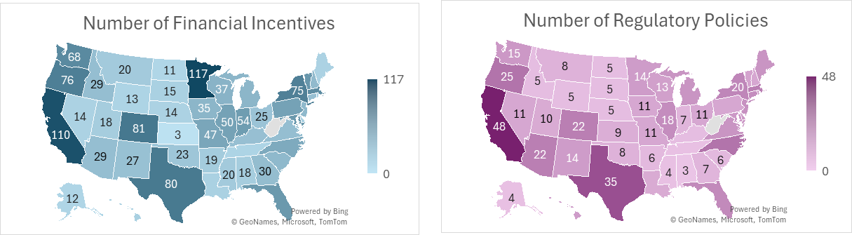
DSIRE Data
Database of State Incentives for Renewables & Efficiency®
https://www.dsireusa.org/
Fields of Interest
State
Category
Type
Technology
Sector
2,545 records

Slide 4
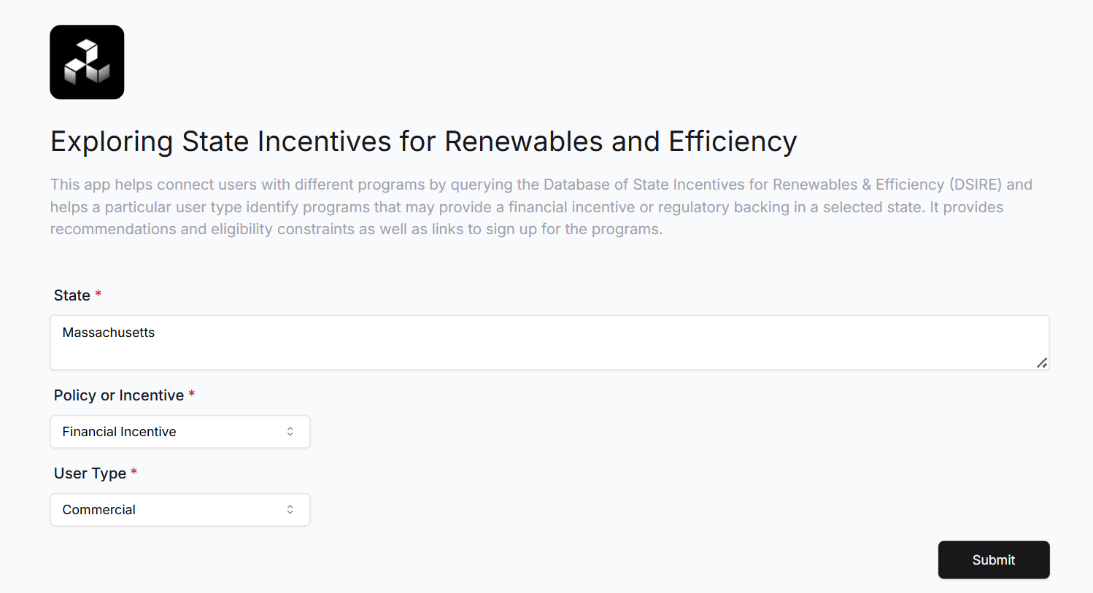
Simple Web Interface
3 Inputs
Dropdown

Slide 5
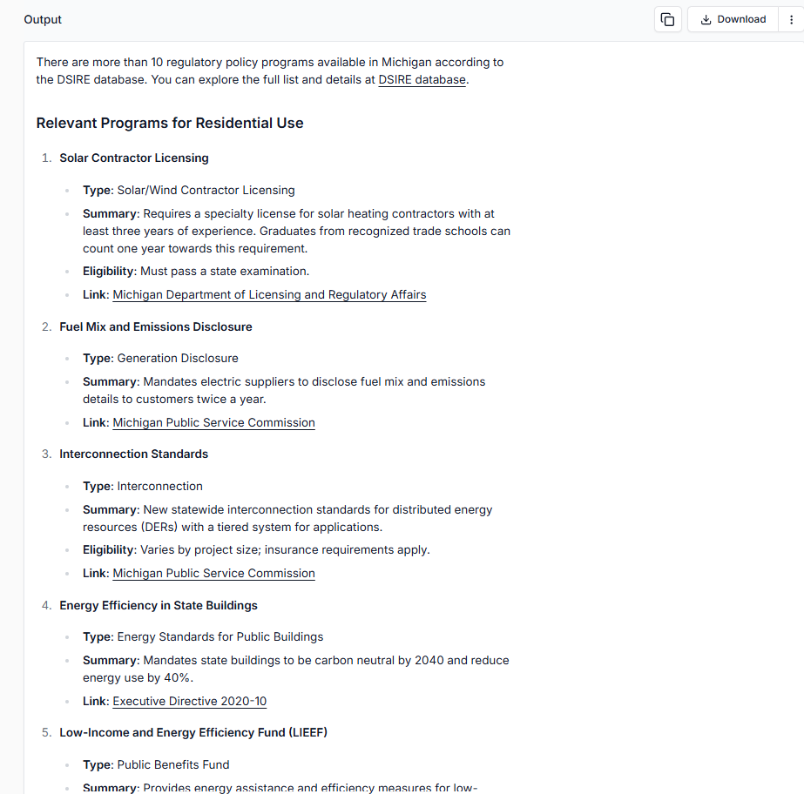
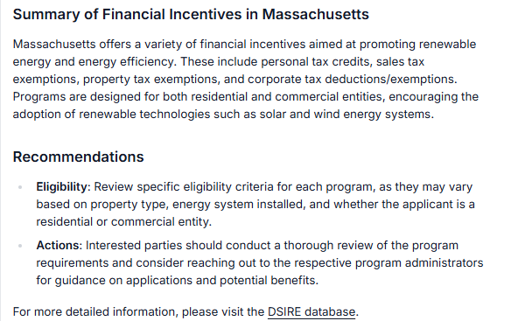
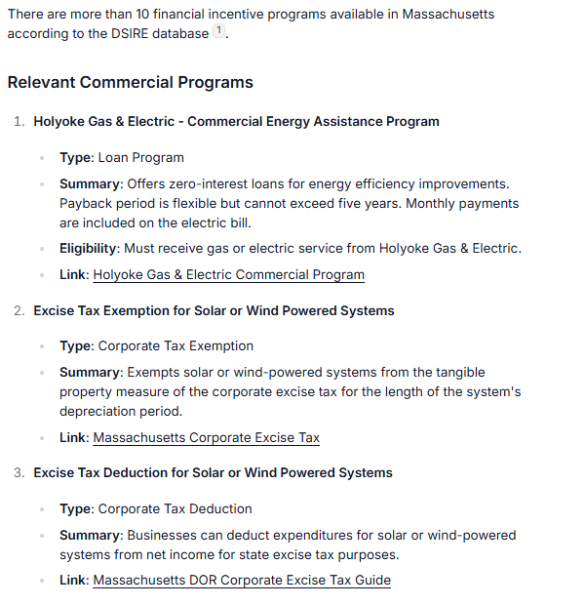
Output Example 1 – MA, Commercial, Incentives
List of Programs and Sign-up Links
Summary and Recommendations

Slide 6
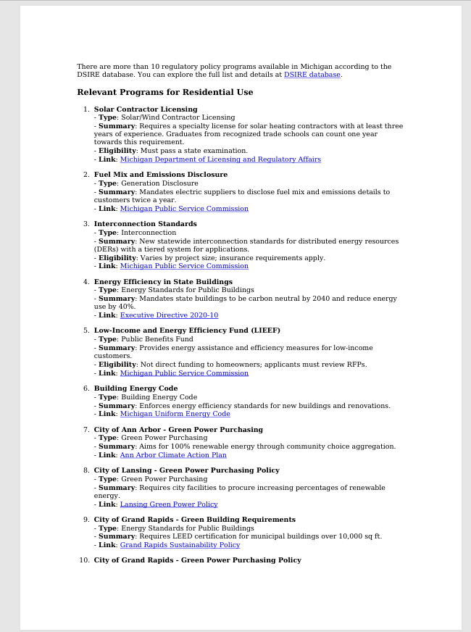
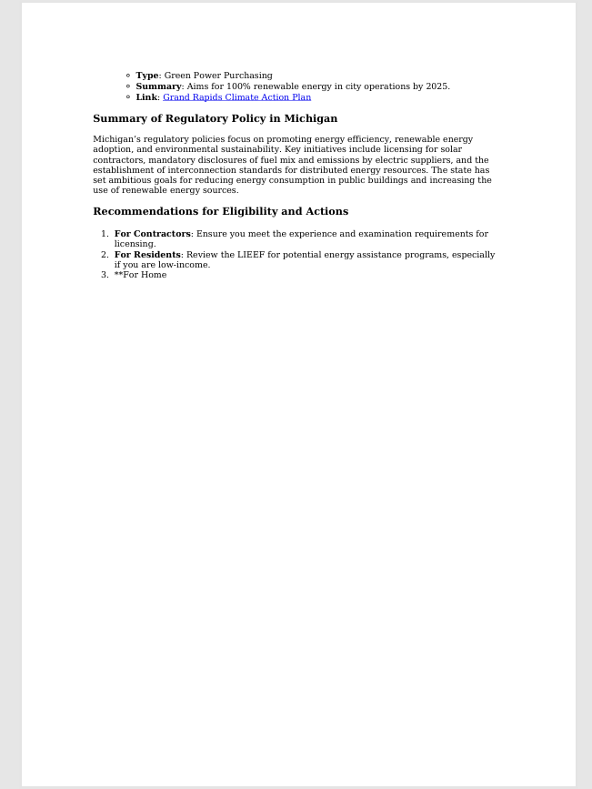
Output Example 2 – MI, Residential, Policies
Downloadable
PDFs

Slide 7
Try it out!
Exploring State Incentives for Renewables and Efficiency

